Slide 1
Accessing the curriculum for diverse Learners
Your practice

Slide 2
Activity
Supporting Students with Diverse Needs

Slide 3
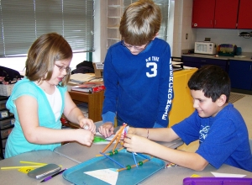
Activity: From Here to Activity
Work in pairs
Analyze the 8 Active Solutions”
How could you improve on any of these ideas?
Join another pair and share

Slide 4

Class Activity: Promoting Independence

Slide 5

Your next steps

